Slide 1
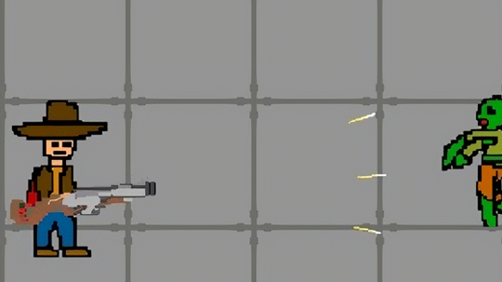
Zombrena
Joshua, Lahzee, Paing, Mansib

Slide 2
Aims & Objectives
“Zombrena” is a game where your survival skills will be put to test against different zombies and bosses.
1. Survive
- Primary Objective: survive 10 intense waves
2. Eliminate
- Goal: Eliminate zombies to create safe zones
3. Upgrade Weapons
- Progression: pickup new weapons every wave to improve your ability to eliminate more zombies

Slide 3
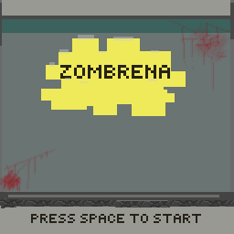
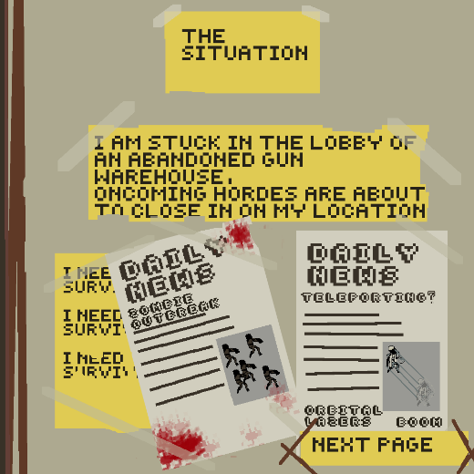
Overview
The setting: The game is set in an abandoned gun warehouse which is surrounded by zombies. As the relentless waves of zombies approaching, players must use their strategies to survive.
Strategy: The player must make quick decisions on weapon choice, positioning and when to fight or flee .
Home Page
The Situation

Slide 4
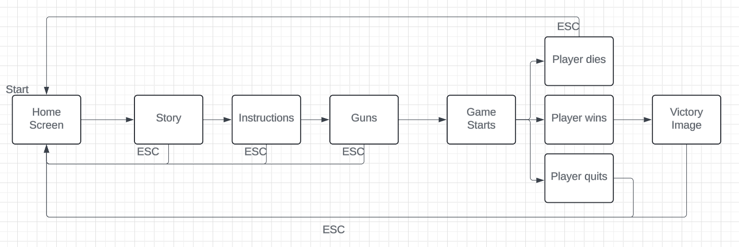
General Flow
General Flow of the Game

Slide 5
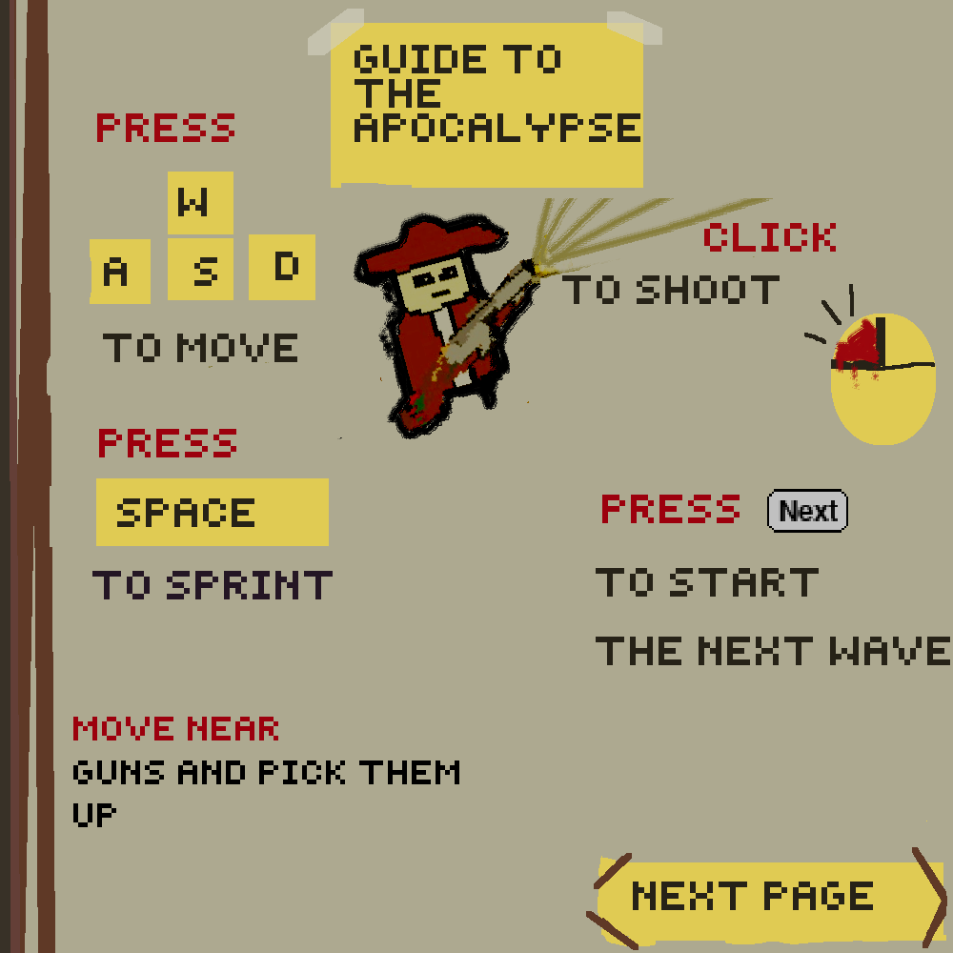
Instructions on How to Play
This Page indicates basic controls, starting the wave, and picking up weapons.
Instructions

Slide 6
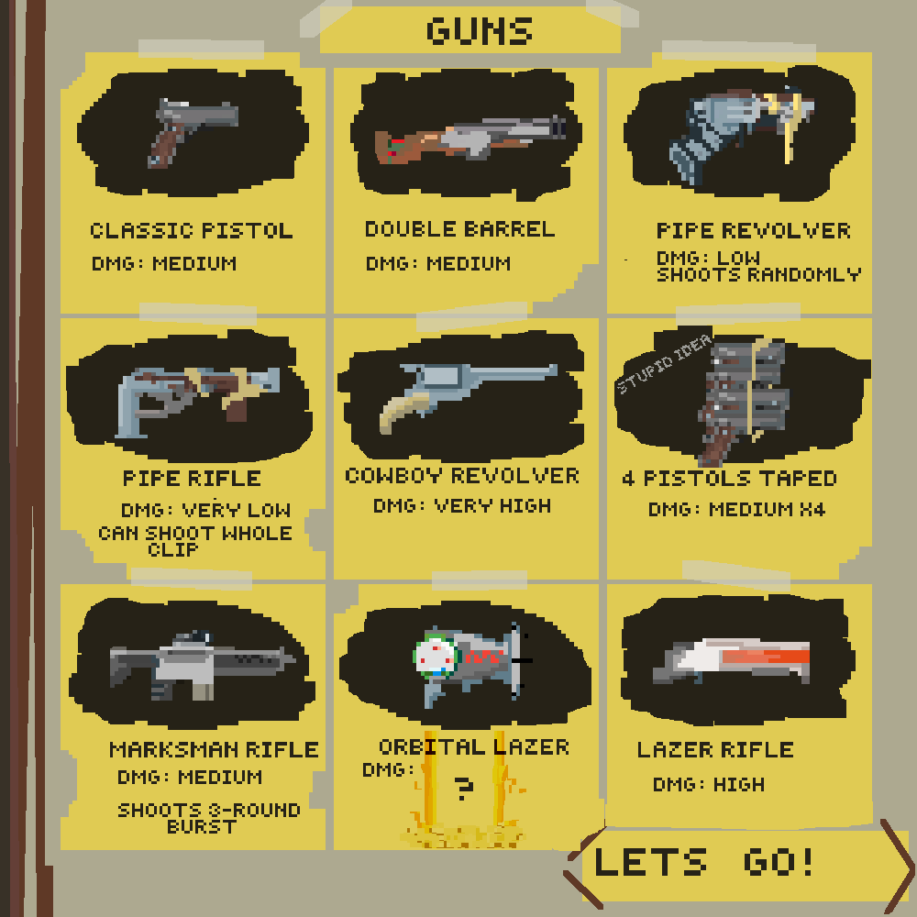
Weapons
Image of weapons
with descriptions
Weapon Descriptions

Slide 7
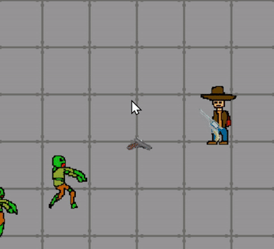
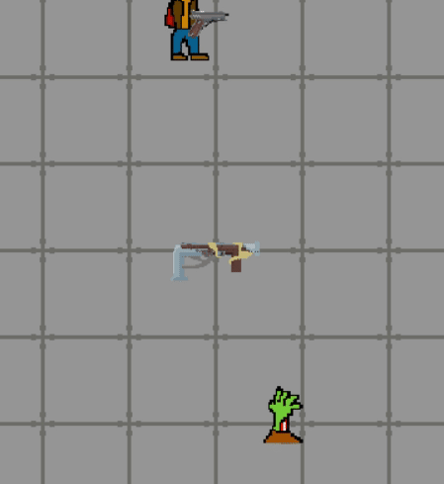
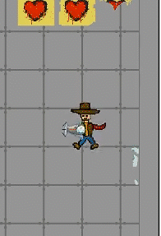
Gameplay Mechanics
Player shooting
Player being hit by zombie
Player moving & picking up weapon
Notes:
How to start/restart/pause
How to move the player & move faster
How to shoot
How to pick up guns
How to know if I got hit (noise)
Health
Length of each wave

Slide 8
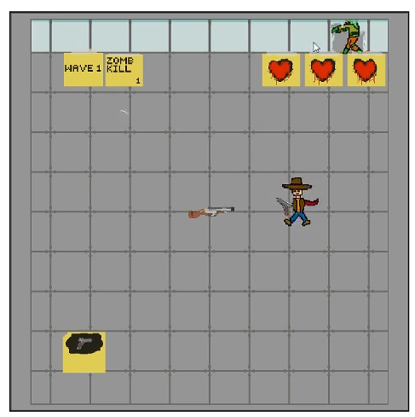
In-Game Interface Overview
Score Display
Location: Top left corner
Function: tracks the number of zombies killed
Health
Location: top right corner
Function: tracks player’s remaining health
Waves Counter
Location: adjacent to score
Function: indicates current wave
Current Weapon
Location: bottom left corner
Function: shows weapon in use
Image of an example gameplay

Slide 9
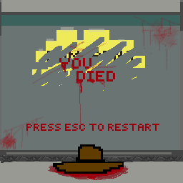
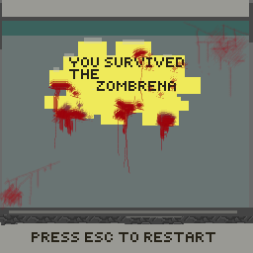
Player Feedback System
Visual Cues | Audio Cues
- Death Screen - Win Screen | - A distinct sound effect plays when the player is hit - Wave music changes in the wave where the boss is spawned
Death Screen
Win Screen

Slide 10
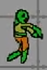
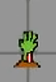
Characteristics of Zombies
Normal Zombie
- Walk towards the player at a normal speed
Underground Zombie
- Spawned randomly on the floor and do not chase the player
Bosses
- Spawned every 2 waves
- Have special abilities
Normal Zombie
Underground Zombie

Slide 11
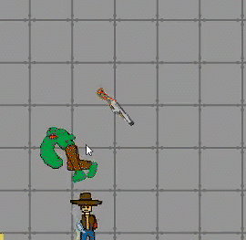
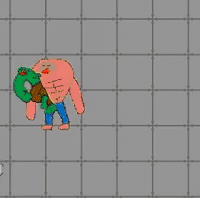
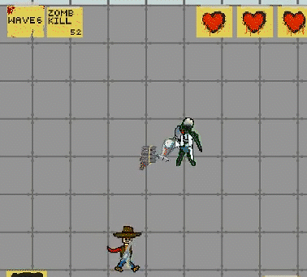
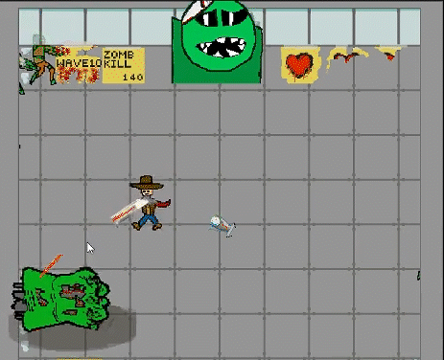
Boss Zombie mechanics
Charger
Tank
Scientist
Final boss
Notes:
Explain each zomb
- scientist: runs away from the player while shooting Orbital lazer
- tank: has more health and will detach limbs
- charger: run towards the player at a fast pace
- final boss: 2 arms moving randomly while shooting lazer

Slide 12
Code Explanations
Walls/ Floor
Shooting / gun complexity
Zombies
Sprite sheets
5. Collisions

Slide 13
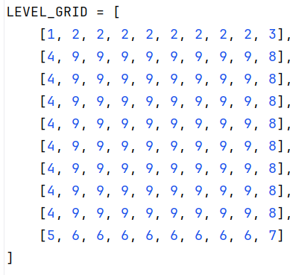
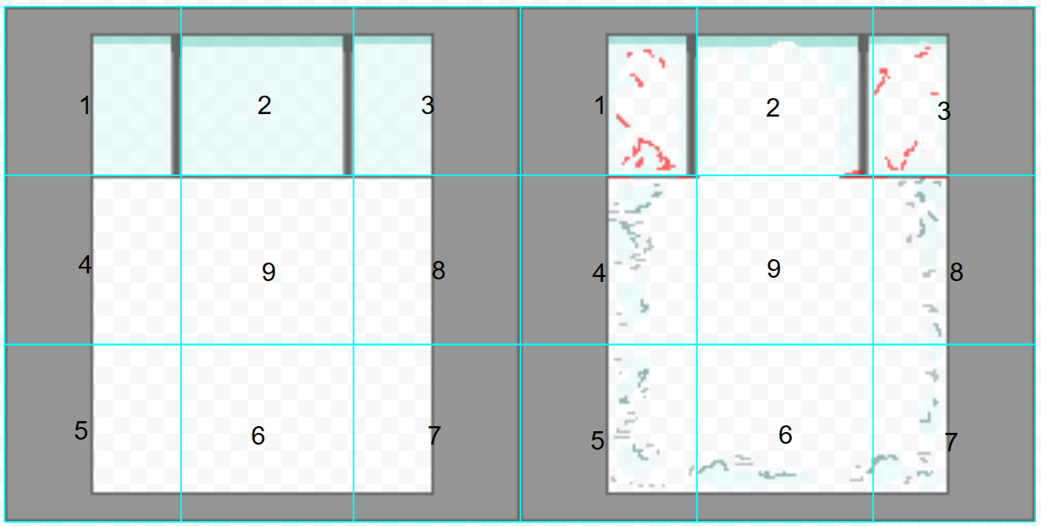
1. Walls
Walls are created using grids, and each grid represents different parts of the image.
Wall Association

Slide 14

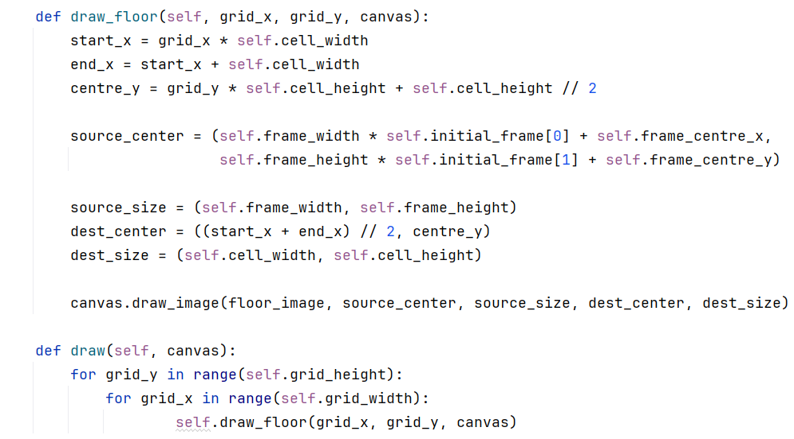
1. Floor
Every 9 on the grid, is a space for a block of floor
floor

Slide 15
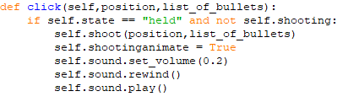
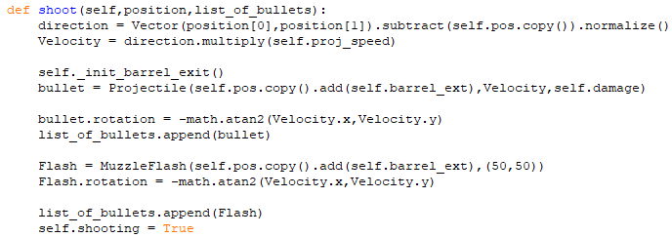
2. Shooting
Shooting as a mechanic is really simple

Slide 16
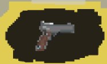
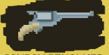
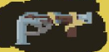
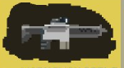
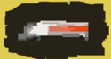
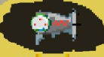
Gun complexity
The guns are separated into 3 categories of complexity
Changed pattern of fire
Special weapons
Basic firing
Minor Stat tweaks
Stat tweaks + different patterns of bullet spread
Essentially coded in a new firing mode, with new sprites

Slide 17
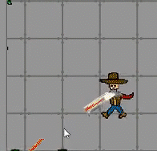
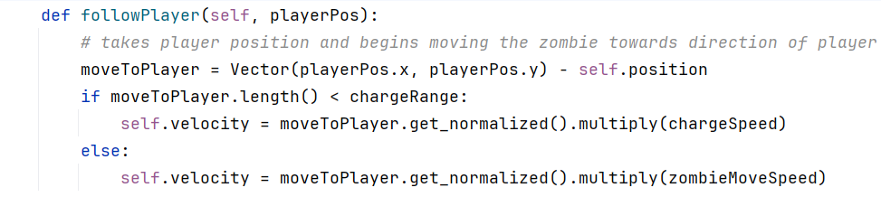
3. Zombies
Zombies track player's vector position by subtracting their current distance from themselves to player.
Depending on the value given, they will move accordingly in the frame towards the player. Getting closer to the player makes the zombies speed up and track the player faster

Slide 18
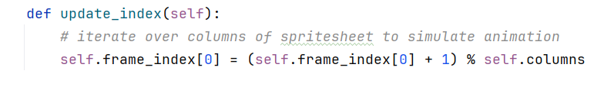
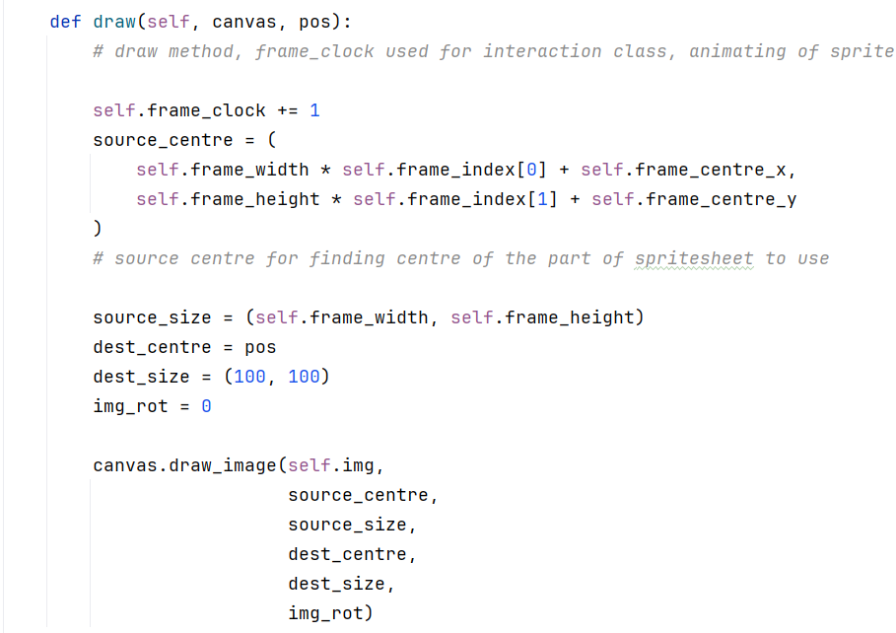
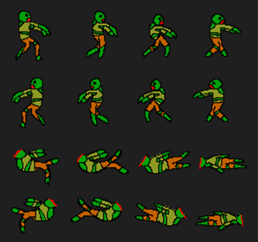
4. Sprites
Handled through spritesheets, which contain animations of sprites spliced into different locations of the image
Take the frame centre along with the dimensions of which part of the spritesheet we want on screen, then draw the image with said specific dimensions.

Slide 19
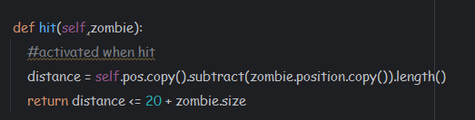
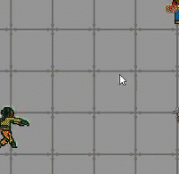
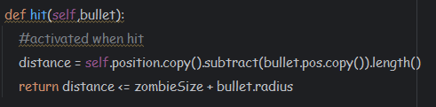
5. Player collision
Handler is used in the interaction class to check whether a zombie is within range of player's hitbox by subtracting the length between both objects on frame. If it is considered colliding, then various events can happen, including removing health from the player.
Similar handler is used for checking whether bullets collide with zombies

Slide 20
Summary
Survival challenge
Survive all 10 waves and win
Strategic combat
Kill zombies and bosses
Weapon evolution
Each wave generates a random weapon

